Slide 1

CGI + ULL:
Advance ForwaRD
Discovering Collaborative
Student Research Experiences
William LaBar, Vice President
Jacquelyn Schulz Craddock, Workforce Initiatives, Strategic Operations

Slide 2
Agenda
01
02
03
04
Overview of CGI
CGI’s Strategic Planning and Collaboration Approaches
Idea Exchange and Discovery of Future Opportunities
Open Discussion
and
Contact Information
Notes:
1. Who is CGI? –
2. What does CGI do? Design of CGI - Global Delivery, U.S. Onshore Center Overview
3. Why Lafayette, LA? – Partnership with the University of Louisiana – Lafayette
4. Collaboration:
Internships
Capstone Projects
Undergraduate Research
Mixed Mediums
5. Idea Exchange and Discovery of Future Opportunities

Slide 3
CGI at a glance
Founded in 1976 46 year track record of increasing stakeholder value
CA$12.9 billion revenue (Fiscal 2022)
91,000 consultants, with attrition below IT Services industry
400 locations
5,500 clients benefiting from end-to-end services
200+ IP-based solutions serving 50,000 clients
52%
48%
US$2.16T
Global IT Services spend across
all industries and geographies
where CGI is present
▌ Revenue from North American segments
▌ Revenue from European segments
▌ Global delivery centers: 39% of total employees
(23% offshore & 16% nearshore)
© 2023 CGI Inc.
Notes:
INTERACTIVE MAP, CLICK ON A SPECIFIC REGION TO ZOOM-IN
CGI is one of the few firms with the scale, reach and capabilities to meet clients’ digital transformation needs. We provide innovative, end‑to‑end IT and business consulting services through our client-proximity business model, working side-by-side with clients and drawing upon our global capabilities to help identify, develop, implement and operate the strategies and solutions needed to meet their customer and citizen expectations.

Slide 4
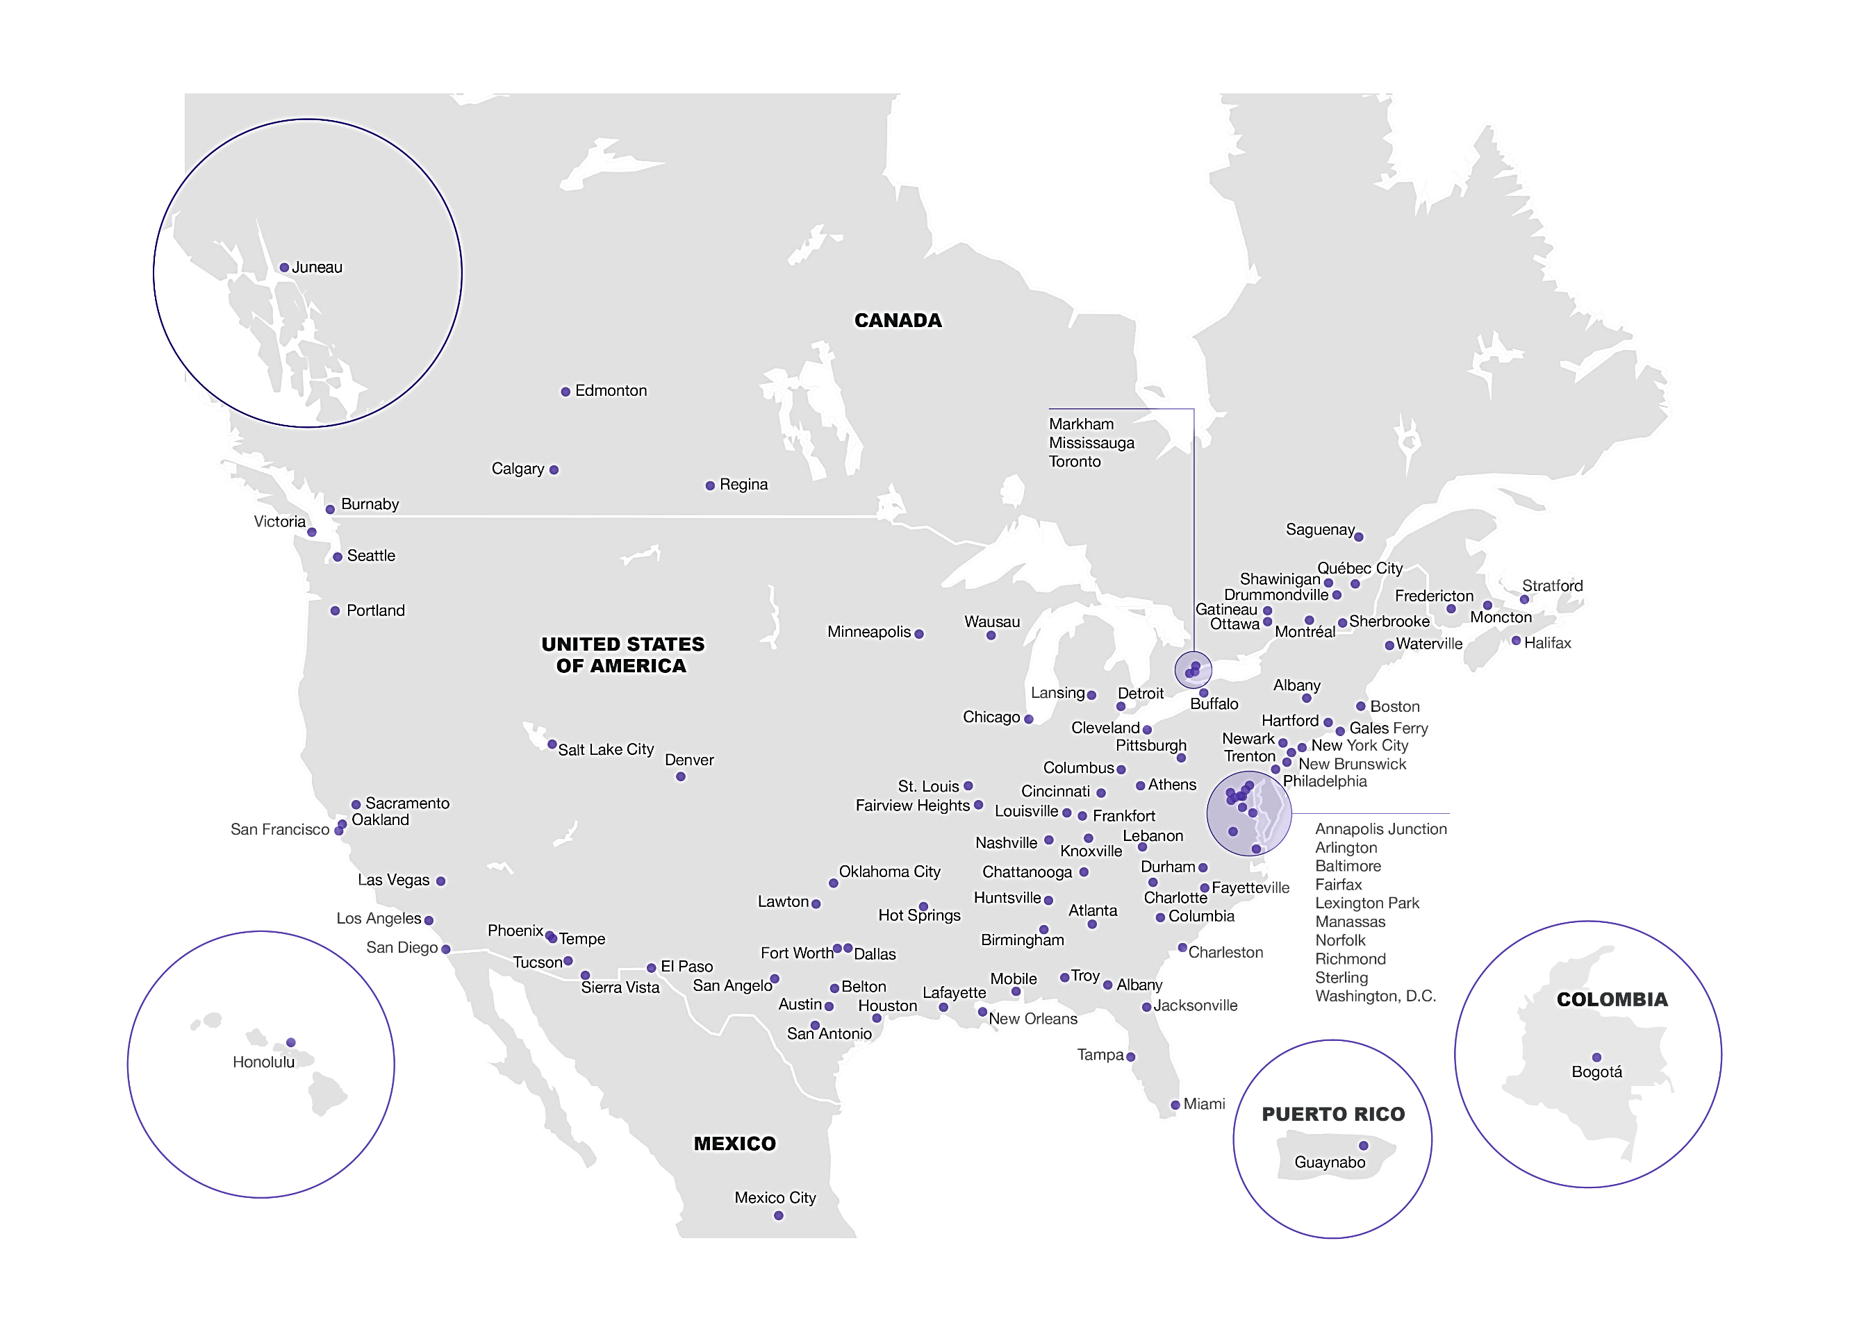
The Americas
29,000 members
 CGI at a glance
Notes:
CGI delivers an end-to-end portfolio of capabilities, from high-end IT and business consulting to systems integration to IT and business process outsourcing services. Our services are supported by our unique differentiators:
Client-proximity model: CGI organizes operations within metro markets where clients have concentrated footprints. Our client-proximity model empowers local teams to build strong, trusted, in-person relationships and ensure accountability for delivering client success. Through this proximity, CGI gains deep knowledge of our clients’ businesses and industries and stays attuned to market and cultural needs. It also enables us to deliver innovative solutions proactively, and to grow alongside our clients.
Domain expertise: Through our focus on 10 industries and dozens of sub-industries, we provide local experts who understand clients’ industries and local business environment. These experts are supported by global insights coming from our network of industry-focused centers of excellence, emerging technology practices and global delivery centers, providing clients with applied innovation, clarity of accountability, and measurable results.
Intellectual property: CGI’s 150+ digital business solutions support our clients’ mission-critical business functions and accelerate their digital transformation. These industry and cross-industry solutions include digital-enabling software applications, reusable frameworks and innovative delivery methodologies such as Software as a Service.
Global delivery network: At CGI, our best-fit global delivery model includes onshore, nearshore and offshore delivery centers that support client-proximity teams in accelerating clients’ transformation. With skilled resources operating under a common governance model, centers are strategically located throughout North America, Europe and Asia Pacific to provide the best mix of services configured to clients’ needs and preferences.

Slide 5
Range of services and differentiators
End-to-end services | Business and strategic IT consulting |  | Systems integration | Managed services
 | Intellectual property solutions and services as value creation accelerators for clients
Differentiators |  | Client-proximity model
 |  | Global antenna for the benefit of our clients
 |  | Local and global expertise by industry
 |  | Global delivery network
Notes:
Customer and citizen demand for new digital services continues to shape our clients’ priorities and key initiatives for becoming digital. At the same time, technology no longer just enables change; it drives it. Given this, technology is moving from being a support function to being core to clients’ business and operations. Yet, as technology becomes more important, humans continue to be the key asset.
In the midst of these profound changes across industries, clients increasingly favor global, end-to-end services firms. They require trusted partners with deep industry and technology knowledge, and a proven ability to provide relevant advice while delivering quality and innovation anywhere in the world.
CGI delivers an end-to-end portfolio of capabilities, from high-end IT and business consulting to systems integration to IT and business process outsourcing services. Our services are supported by our unique differentiators:
Client-proximity operating model: CGI organizes operations within metro markets where clients have concentrated footprints. Our client-proximity model empowers local teams to build strong, trusted, in-person relationships and ensure accountability for delivering client success. Through this proximity, CGI gains deep knowledge of our clients’ businesses and industries and stays attuned to market and cultural needs. It also enables us to deliver innovative solutions proactively, and to grow alongside our clients.
Global antenna for our clients: Through the CGI Client Global Insights, we provide a valuable global antenna by industry—based on facts, not hype—to benchmark best practices that lead to continuous improvement. Our benchmarking data comes from a knowledge-base that reflects insights from 5,500 client organizations located in countries representing 82% of the world’s IT spend.
Industry expertise at the local level: Through our focus on 10 industries and dozens of sub-industries, we provide local experts who understand clients’ industries and local business environment. These experts are supported by global insights coming from our network of industry-focused centers of excellence, emerging technology practices and global delivery centers, providing clients with applied innovation, clarity of accountability, and measurable results.
Intellectual Property built in collaboration with clients : CGI’s 170+ digital business solutions support our clients’ mission-critical business functions and accelerate their digital transformation. These industry and cross-industry solutions include digital-enabling software applications, reusable frameworks and innovative delivery methodologies such as Software as a Service.
Global delivery network focused on outcomes: At CGI, our best-fit global delivery model includes onshore, nearshore and offshore delivery centers that support client-proximity teams in accelerating clients’ transformation. With skilled resources operating under a common governance model, centers are strategically located throughout North America, Europe and Asia Pacific to provide the best mix of services configured to clients’ needs and preferences.

Slide 6



















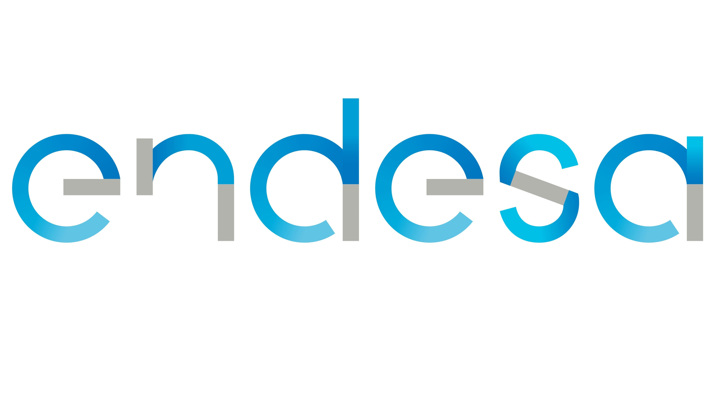



















































A representative view of our clients
Banking
Communications
Energy and
Utilities
Government
Health and Life Sciences
  Working with 15 of the top 20 banks globally
  14,000 banking consultants help
  500+ financial institutions worldwide
  Partnering with 6 of the world’s top CSPs
  5,000+ communications consultants focus on the end-to-end needs of our clients
  7,500 professionals worldwide helping 650+ clients
  30+ years partnering with average relationship tenure with world’s largest energy and utilities companies
  23 industry software IP solutions
  Partnered with
  2,000 government clients in 28 countries
  25,000 consultants partner with government clients worldwide
  Over $3 billion in improper medical claims payments recovered
  5,000+ consultants
Notes:
CGI has a sustained focus on 10 key industries where IT is a strategic driver and enabler of transformation and value creation.
In combination with our proximity model, our industry expertise enables us to serve as a trusted partner that provides substantive and actionable counsel to empower clients to accelerate their transformation. Our industry focus also supports CGI’s ability to deliver unique business consulting and IP-enabled services, driven by lessons learned with our clients over 40 years.
Across the industries we serve, we continuously examine each industry’s current state, the drivers for change, the future state, and the attributes of winners. While there are a number of similarities across industries, we recognize that executives experience transformation in the context of their industry, geography and organizational culture. In all scenarios, technology is no longer just an enabler; it is a driver of business transformation.
CGI works with leaders across these industries to evolve, at the right pace and scale, into agile organizations that meet customer and citizen expectations.

Slide 7

















































A representative view of our clients
Insurance
Manufacturing
Retail and Consumer Services
Transport and Logistics
Space
  Working with 7 of the top 10 global insurers
  5,000+ insurance consultants support
  200+ clients worldwide
  6,000 consultants support 700+ manufacturing clients
  Partnered with our top 10 manufacturing clients for an average of 27 years
  6,000 consultants support 800+ clients globally
  Partnered with our top 10 clients for an average of 15 years
  200+ clients globally
  4,000 consultants support clients in the aviation, maritime, rail, road, logistics and post sectors
  40+ years of partnership with 100+ space clients
  1200+ consultants in space partner with Space clients worldwide
Notes:
CGI has a sustained focus on 10 key industries where IT is a strategic driver and enabler of transformation and value creation.
In combination with our proximity model, our industry expertise enables us to serve as a trusted partner that provides substantive and actionable counsel to empower clients to accelerate their transformation. Our industry focus also supports CGI’s ability to deliver unique business consulting and IP-enabled services, driven by lessons learned with our clients over 40 years.
Across the industries we serve, we continuously examine each industry’s current state, the drivers for change, the future state, and the attributes of winners. While there are a number of similarities across industries, we recognize that executives experience transformation in the context of their industry, geography and organizational culture. In all scenarios, technology is no longer just an enabler; it is a driver of business transformation.
CGI works with leaders across these industries to evolve, at the right pace and scale, into agile organizations that meet customer and citizen expectations.

Slide 8

Culture of ownership and accountability
We offer and deliver high quality in our work and your results
84%
Member Shareholders
95%
Projects delivered
on-time and within budget
9.4/10
Client Satisfaction score, signed by clients
9.0/10
Client Innovation score
Notes:
INTERACTIVE CHART, CLICK ON ‘95%’ TO ACCESS ‘EAS RISK MANAGEMENT’ SLIDE OR CLICK ‘9.0/10’ TO ACCESS ‘INNOVATION’ SLIDE
Our commitment to exceed the expectations of our clients is demonstrated by an overall 9 out of 10 client satisfaction score, reported directly by our clients through in-person satisfaction assessment sessions; and, our industry-leading 95% on-time, within budget project delivery track record, is a testament to our commitment to operational excellence.
Going above and beyond to deliver value for our clients Our clients are satisfied when we bring practical innovation that helps them create new business value. Proactive listening serves as a key step in delivering this value through innovative services and solutions.
Through our Client Satisfaction Assessment Program (CSAP), we meet in-person with clients to evaluate our performance and discuss further ways we can help. The CSAP assessments, which clients sign, represent a “report card” on CGI’s performance — one that demonstrates a commitment to continuous improvement.
Client satisfaction scores, signed by clients 2023 vs 2021 scores:
Overall satisfaction 9.36/10 vs 9.3/10
Client loyalty 9.53/10 vs 9.43/10
Industry knowledge 9.32/10 vs 9.24/10
Technology expertise 9.23/10 vs 9.19/10
Innovation 9.04/10 vs 8.96/10

Slide 9
CGI is built to grow and last..
91,000
$13B
Number of members
Revenue
70,000
$10.7B
Umanis Integration
25,000
$3.5B
Logica Integration
1,800
$122M
2
$138k
225
$22M
AMS Integration
Our Management Foundation
CGI is founded
1976
1986
1996
2006
2016
2023+

Slide 10
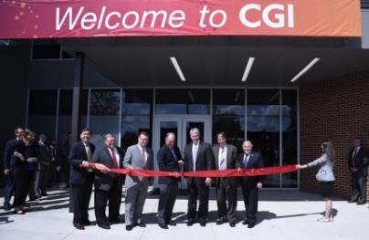
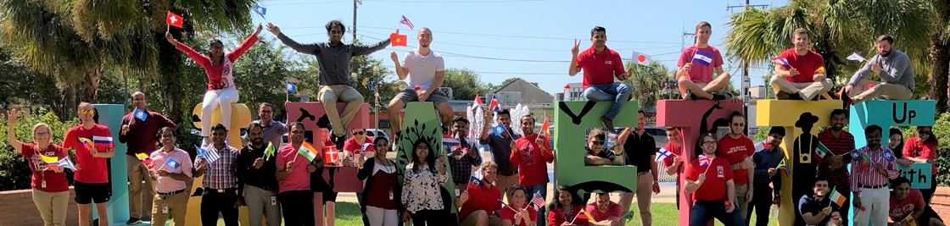
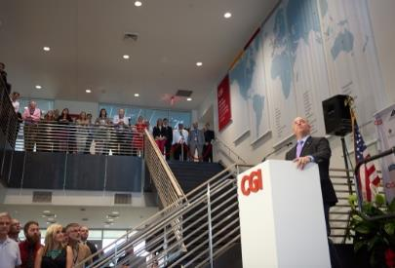
Lafayette Center of Excellence – a Public/Private Partnership Anchor
Over 700+ dedicated IT professionals in the heart of Acadiana
Opened 2014
Achieved goal of 400 jobs in 4 years; New target of 800 jobs
Anchor of $13.1M, 50,000 sf. facility at UL + Downtown location at our new Versailles Center
Estimated annual economic impact of $180 million/year
Partnerships
Louisiana Economic Development / Lafayette Economic Development Authority / UL Lafayette
One Acadiana Executive Committee, Downtown Lafayette Unlimited
Portfolio of work
Software Development, Cloud and Hybrid IT, Managed IT Services, Cybersecurity, AI, Advanced Data Analytics
> 90% of our consulting services are “imported revenue”
Workforce development and talent attraction
Approx. 75 Early Career Professionals hired/year
Interdisciplinary Project Based Learning program with UL Computer Science + Informatics (40 students/semester)
Internships (High School, Community College, University)
Apprenticeship and Academy Programs for diverse and career transitioning workforce development
Roster: 22% of our team relocated to Louisiana; 60% originally from Acadiana before joining
Community engagement
STEM@CGI equity based programming has reached 40 schools in the Acadiana region
Pro bono IT consulting with Love Our Schools, Link and Learn, Parish Proud, Acadiana Center for the Arts
Member of UL Center for Visual & Decision Informatics,
a NSF funded national research center

Slide 11
Strategic Planning and Collaboration Patterns

Slide 12
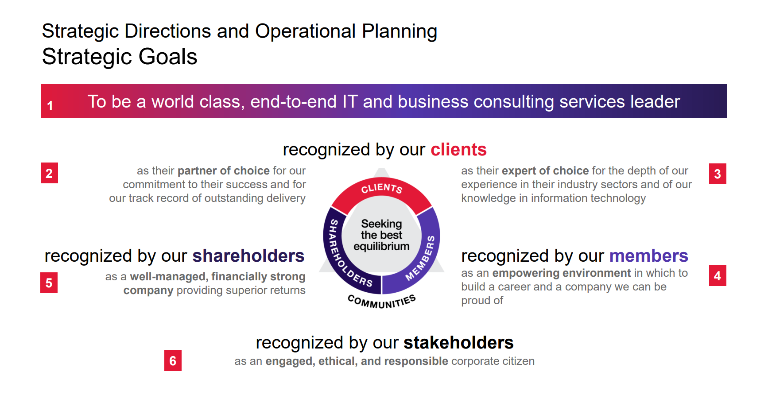

Slide 13
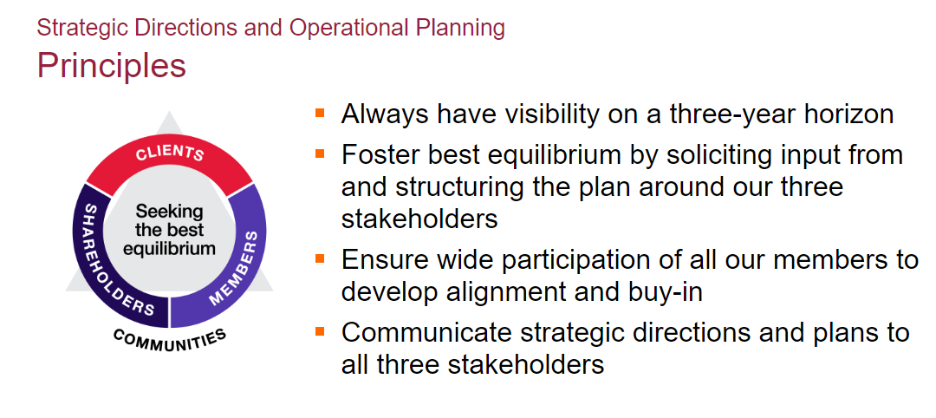

Slide 14
Voice of Our Clients: Insights you can act on
Depth of our insights
2023 discussions
1,764 discussions | 1,454 CXOs & direct reports
38% business leaders | 62% IT leaders
8 major regions | 14% new clients
$60B annual IT spend (CAD)
Over the past 5 years, 1M data points have been collected for trending purposes
2023 CGI Voice of Our Clients
Notes:
Conducted annually, the CGI Voice of Our Clients is a comprehensive study created through one-to-one interviews between CGI leaders and business and IT executives to gather their perspectives. From data gathering through in-depth analysis to reporting, the study covers 21 sub-industries across the world to deliver a unique insight into the evolution of the trends, priorities, challenges, actions and requirements impacting clients year-over-year.

Slide 15






Our rolling 3 year horizon is a global antenna focused on megatrends that require organizations to constantly adapt
Geopolitics
Globalization is reversing: world trade is no longer keeping up with economic output.
Climate
Pressures to decarbonize are increasing; governments are requiring companies to do more to protect the climate.
Economy
Value chains are changing – also in response to deglobalization.
Social trends
A persistent lack of skilled workers is creating a need for new labor models.
Technology
Consumers’ digital appetites can only be satisfied with end-to-end digital solutions.
Acceleration
Volatility is increasing across the board: economically, geopolitically, technologically, and socially.

Slide 16
CGI partners with universities to inform our strategy related to the impact these global trends have on our clients and our workforce
Weaving together three partnership strategies results in a platform for innovation that benefits universities, students, CGI, and our clients.
Workforce Development
Grant Partnerships
Research and Development
Undergraduate Internships
Capstone and Project Based Learning programs
Apprenticeships and Incumbent worker training programs
Jointly partner on grant strategy and solutioning (e.g. NSF ExLENT)
Integration of CGI Client & domains
Pairs with workforce development
CGI + Client advised research and development
Research Center investment (e.g. CVDI)
PHD or Post-Doctoral research
CGI and UL Lafayette are helping to define these areas of innovation across CGI in the U.S.

Slide 17

NSF ExLENT Grant: ASSET
AddreSSing the TalEnt and DiversiTy Gap in Biotechnology Workforce
  Project ASSET ($1M) aims to fill the talent and diversity issues in the biotechnology workforce by providing high impact practices in University of Louisiana (UL) System undergraduate research and CGI internship experiences through building a cohort model of 18 black male students in Louisiana per year (54 total for three years/cohorts).
01
02
03
Summer Undergraduate Research Experience
(after Sophomore year)
CGI Summer Internship
(after Junior year)
Graduation + CGI Consultant
Summer 2024, 2025, 2026
Build on and expand the Lewis scholar model at UL
Work in groups, apply classroom skills and theory to solve biotechnology-related problems, opportunities to present research findings to the higher education community
Summer 2025, 2026, 2027
Hands-on experience in field of study, exposing scholars to cutting-edge research and technologies
Mentored by professionals in the industry, allowing professional and intellectual capital to be collectively shared across the cohort
Addresses the lack of diversity in the industry, bringing different perspectives and experiences to problem-solving and decision-making, leading to more creative and effective solutions
Provides students direction and sense of purpose and ownership in their learning and towards biotech career
Notes:
3 cohorts of 18, 60% of funding flows to CGI to cover wages and related costs, 40% covers UL costs

Slide 18
Idea Exchange
Discovery of Future Possibilities

Slide 19

Life Sciences | CGI.com
Helping life sciences organizations increase speed, efficiency and innovation, while keeping pace with compliance demands
Health & Life Sciences
CGI has helped optimize processes to launch novel therapies for cancer, COVID and rare diseases
~6,000 Health & Life Sciences consultants helping clients drive profitable growth
6.6 billion records stored for health systems and 700+ biotech / pharmaceutical projects completed for clients
11 of the top 20 biotech and pharmaceutical clients served globally
2023 CGI Voice of Our Clients
Notes:
Q1.3b by main industry (Health & Life Sciences) (1=highest impact)
Next slide highlights Life Sciences

Slide 20

Federal Health Services
Improving health care delivery, research, and administration for the nation’s federal health agencies
Nursing, Health Sciences
Leveraging over 20 years of domain expertise and world-class technical proficiency to deliver mission-critical capabilities to the nation’s federal healthcare community, including the Center for Medicare and Medicaid Services (CMS), the Centers for Disease Control and Prevention (CDC), the National Institutes of Health (NIH), the Food and Drug Administration (FDA) and the Defense Health Agency (DHA), the Department of Veterans Affairs and others.
Health and Human Services
Reducing risk and improving outcomes
Notes:
Notes:
Federal Healthcare Solutions:
Momentum
Sunflower Asset Management
CGI PulseAI
CGI CustomerAdvance
CSG Health and Human Services key capabilities:
Child welfare expertise, services offerings and technology implementation experience
Child support services and CGI Transcend for Child Support – our solution built for child support programs by child support experts
Modular, incremental modernization approach for complex systems
Business process management for applications on client premises or in the cloud
Master data management and analytics to support customer-centric services
Also, read about CGI's healthcare expertise across the public and private sectors.

Slide 21

WindEurope 2023 | CGI.com
Learn about our study: AI for the prediction of failures in wind turbines
Engineering, Sciences
In response to the need for climate action, energy distribution companies are demanding a shift to renewable energy sources, such as wind.
However, wind turbines are vulnerable to several factors that cause mechanical failure. Repairs are expensive and lead to production downtime, significantly reducing the renewable energy transmitted to the grid.
To investigate this problem, CGI supported an academic study about “Artificial Intelligence in the Prediction of Failures in Wind Turbines” using CGI’s Renewable Management System (RMS). The study explores the implementation of a machine learning system that enables owners to predict wind turbine failures.
Notes:
Notes:
WINDExchange: Wind Energy in Louisiana
Louisiana approves $1 billion wind farm project - Talk Business & Politics
Louisiana Lays A Plan For Green Offshore Wind Makeover (cleantechnica.com)

Slide 22

STEM@CGI
Building tomorrow’s talent in our communities
Education, Engineering, Sciences
CGI STEM Camps across the country, which serve as the flagship program of STEM@CGI. During the daylong camps, students are introduced to software coding, computer hardware and other important IT skills and concepts. CGI has completed 45 camps in the US and has many more planned.
Congressional App Challenge Mentorship Program - CGI members have mentored 30 teams in two US locations. To date, two of the teams have won the challenge for their district!
IT Girl Challenge - This is one of CGI’s Dream Connector programs. High school girls work in teams to create a mobile app. The winning team receives a college scholarship.
Notes:
Notes:
College of Education & Human Development:
4-Year Plan | Department of Educational Curriculum & Instruction (louisiana.edu)
Partnership with STEM@CGI
Opportunity to collaborate on intensives, specific short-term training on technologies that can be embedded in classroom learning
Research to leverage emerging technologies including AI into classroom learning

Slide 23

Insurance | CGI.com
We help insurance companies build modern infrastructures
Economics, Finance, Insurance
CGI is the partner and expert of choice for P&C and life insurers, brokers and agents across the globe, including 7 of the top 10 global insurers and 200+ clients worldwide.
Our 3,500 insurance professionals deliver end-to-end services and solutions that help insurers become digital organizations across all areas of their business, including people, processes and technology.
Our 40 years of insurance experience includes policy, claims and billing system implementations across the globe and the development of innovative solutions such as CGI Ratabase, the industry’s leading rating and product configuration software.
Notes:
Notes:
Programs | Department of Economics & Finance (louisiana.edu)
We also manage the annual delivery of more than 15 million risk information product transactions and process more than $50 billion in premiums through the systems that we manage for our clients.

Slide 24

Banking & Financial Services
Reinventing the movement of money in a digital-first, real-time world
Business Admin, Accounting, etc.
10 of the 15 top U.S. banks partner with CGI
25+ banking solutions covering payments, credit, trade finance, wealth management and more.
45+ years in the banking industry
CGI serves as a trusted partner in helping clients find new revenue streams, bring their innovations to market quickly, modernize their infrastructure, and migrate to the cloud - all in service of delivering a customer experience that's second to none.
Customer-centric approach
Innovative business models
IT modernization
Operational efficiency
Merger and acquisition expertise
Notes:
Notes:
B.I. Moody III College of Business Administration Academic Affairs Division (louisiana.edu)

Slide 25
What ideas do you have?

Slide 26


CGI Lafayette Team
Center Leadership
Will LaBar
Vice President
CGI Onshore Delivery Program and Corporate Social Responsibility Leader
William.Labar@cgi.com
M: 337-281-2066
Jacquelyn Schulz Craddock
Workforce Initiatives
U.S. CSG Strategic Operations
Jacquelyn.Craddock@cgi.com
M: 865-386-1518

Slide 27
Insights you can act on
At CGI, we are insights-led and outcome-based to help clients accelerate returns on their investments.

Slide 28
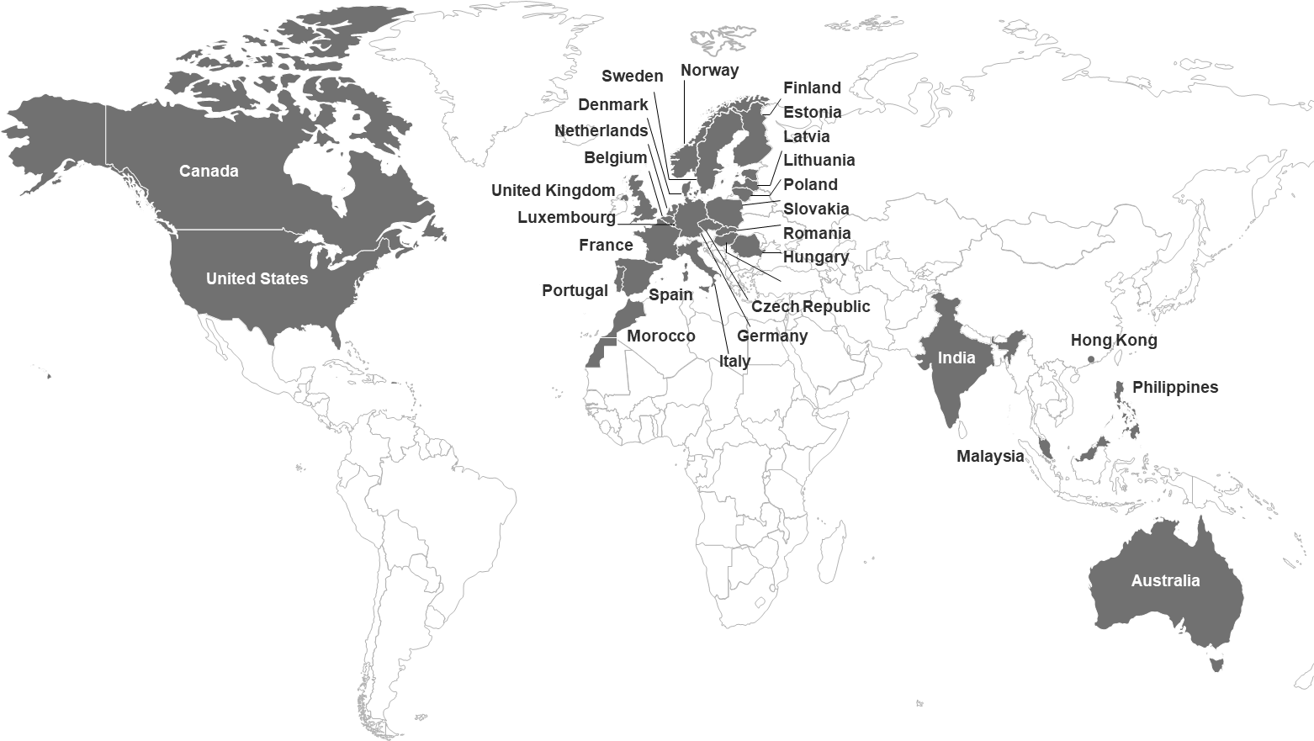
We are CGI
Europe
35,500
staff
Founded in 1976 46 years of excellence
CA$12.9 billion revenue
90,000 consultants
400 locations in 40 countries
5,500 clients benefiting from end-to-end services
Serving 50,000 clients through our IP-based solutions
Americas
26,000
staff
Asia Pacific
15,500
staff
◄ We are CGI
CGI NL ►
Notes:
INTERACTIVE MAP, CLICK ON A SPECIFIC REGION TO ZOOM-IN
CGI is one of the few firms with the scale, reach and capabilities to meet clients’ digital transformation needs. We provide innovative, end‑to‑end IT and business consulting services through our client-proximity business model, working side-by-side with clients and drawing upon our global capabilities to help identify, develop, implement and operate the strategies and solutions needed to meet their customer and citizen expectations.
Our global footprint of 400 offices located across 40 countries includes 77,000 members, a majority of whom are shareholders, who serve as trusted partners to over 5,500 clients globally. With more than four decades of sustained growth, we provide focused expertise in 10 industries, and augment our services with a portfolio of over 175 IP-based solutions.
ALTERNATIVE VOICE OVER
CGI is one of the world’s largest independent IT suppliers, offering a full range of end-to-end services.
We realize that business isn’t just about where you’ll go and how you’ll get there. It’s also about who you’ll team with. That’s why, as a publically listed family company, we are committed to driving engagements more accountably and responsively than any other company of our kind.
Our clients recognize our commitment to their success by providing an overall client satisfaction score of 9,2 out of 10.
In the 2021 IT Services study by Whitelane Research and Quint CGI Netherlands is ranked 2nd in overall customer satisfaction and even 1st when it comes to business understanding, confirming our leading role in topics such as improving service delivery and innovation in collaboration with clients.

Slide 29
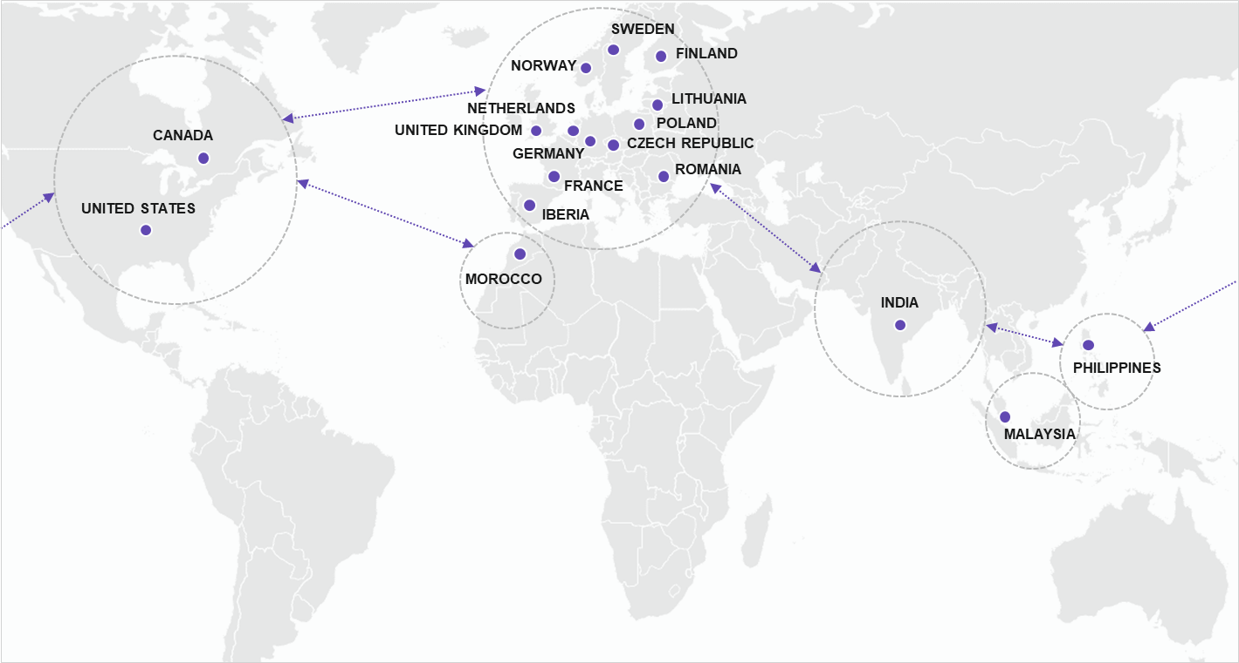
Our global delivery model complements our proximity model to offer end-to-end capabilities
Access to the right skills, right locations, at the right time, and the right price
30,160+
experts
33
delivery centers
9
technology centers

Slide 30
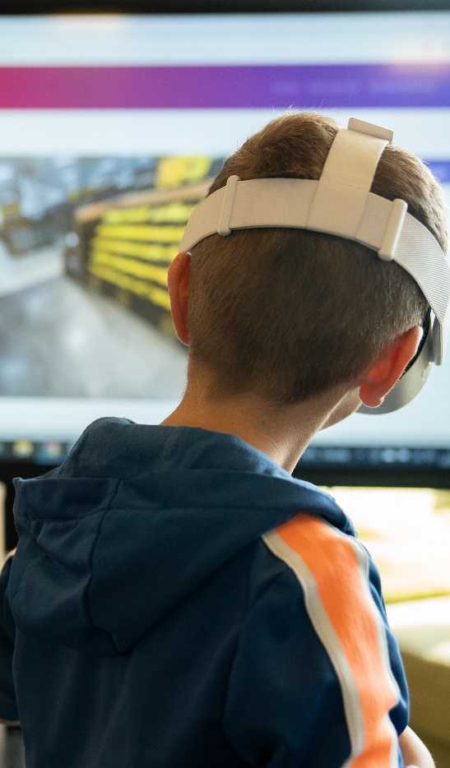



Our commitment to a more sustainable and inclusive world
We strive to be recognized globally as an engaged, ethical and responsible corporate citizen.
65%
Reduction in
CO₂ emissions since 2014, aiming for
net-zero in 2030
58%
Business units implemented pro bono projects, aiming for 100% by 2026
58%
Significant suppliers assessed on ESG criteria, aiming for 70% by 2025
33%
SBU Presidents who are women, aiming for the same level of diversity representation at the leadership levels as the company as a whole by 2025
80/100
Top 1%
62/100
We are committed to the corporate responsibility initiative and its principles in the areas of human rights, labor, environment and anti-corruption.
Access the
2023 ESG Report 
Industry average score: 47
Industry average score: 27
Notes:
Speaker’s notes:
At CGI, we believe we have a responsibility to contribute to creating a more sustainable and inclusive world. Built in the Dream on which CGI is founded and a core value, Corporate Responsibility is also a key strategic goal.
CGI remains an invested, ethical and responsible corporate citizen within the communities in which we live and work, empowering all its professionals to actively engage. We prioritize partnerships with clients, while also collaborating with educational institutions and local organizations on three global priorities: People, Communities, and Climate.
The people priority focuses on championing digital inclusion for all, taking actions locally to improve access to technology and business education and mentoring in order to ensure everyone can be successful in a digital society as citizens or IT professionals.
The communities priority focuses on committing to positively contribute to society by leveraging our IT and business expertise through social impact projects, local economic growth initiatives, and by actively supporting local Business Unit pro bono engagements.
The climate priority focuses on demonstrating our commitment to an environmentally sustainable world through projects delivered in collaboration with clients, and through our operating practices, supply chain management and community service activities.
Each year, we report on our environmental, social and governance (ESG) progress in relation to our three strategic priorities, including targets, action plans and progress indicators.
People priority: We continue to cultivate an environment that celebrates differences and fosters belonging while accelerated digital inclusion. In 2023, we accounted for 33% of SBU Presidents who are women, enabling us to reach nearly a 1:1 ratio with our women professionals. We now aim to achieve the same level of representation at the leadership levels as the company as a whole by 2025.
Communities priority: We continued to encourage our professionals to get involved and volunteer their skills and experience to advance the well-being of our communities, with the implementation of pro bono projects by 58% of CGI’s business units. Those combined to volunteering activities enabled us to reach more than one million beneficiaries. Our next step is to extend this type of projects to 100% of our business units by 2026.
Climate priority: CGI remains committed to achieving net-zero carbon emissions globally by 2030, and earlier in some geographies. As per the 2023 ESG Report, we have reduced our CO2 emissions by 65% since 2014. Around 47% of our total energy usage across our operations comes from renewable sources, including 76% of our data center electricity, which we aim to bring to 100% in 2023.
Finally, as a global company and leader in digital services, we also have a responsibility to conduct business ethically and sustainably, and embed these principles in our operating practices and procurement policy. We have assessed 58% of our 250 significant suppliers on environmental and social criteria. We are committed to reach 70% by 2025.
CGI also seeks to be recognized by internationally trusted indices for its ESG engagement, and has progressed year over year.
In 2023, CGI gained 2 points and kept the Platinum rating from EcoVadis, positioning us among the world’s top performing companies in the industry.
With a score of 62/100, the Dow Jones Sustainability Indices (DJSI) positions CGI among the top third of the most responsible companies.
Additionally, CGI is a signatory of the United Nations Global Compact (UNGC). As such, we are committed to the UN principles and sustainable development goals (SDG).
More details on CGI’s progress and achievements are available in the 2023 ESG Report on CGI.com.

