Slide 1



ASRE PATHWAYS
Student Center for Research, Creativity, & Scholarship

Slide 2



WHAT ARE
ASRE PATHWAYS?
Advance Student Research Experience
ADVANCE is the Quality Enhancement Plan (QEP) for the University of Louisiana at Lafayette. In the QEP was a measure to create a Student Center for Research.
ASRE (Advance Student Research Experience) Pathways are a combination of curricular and co-curricular components that include discipline specific skills determined by the department.

Slide 3
Advance Pathways Actions | Advance Pathway Basic | Advance Pathway Distinction | Advance Pathway Excellence
Guidelines for Department Pathway design | 12-36 credit hours required (4-9 courses) No co-curricular events allowed | 12-40 credit hours required (4-10 courses) 2-3 co-curricular events required | 18-40 credit hours required (6-10 courses) 4-5 co-curricular events required
UL Lafayette has adopted these guidelines for the Advance Student Research Experiences (ASRE) Pathways. Course work should include skills or CUREs and co-curricular events are required.

Slide 4

CO-CURRICULAR EXAMPLES
  Conferences (Poster Presentation/Oral Presentation)
  COOPs or Internships
  Competitions (Participation)
  Workshops
  Training
  Mentored Research
  Honors Thesis
  Leadership Experience
  Study Abroad
  Manuscript submission

Slide 5



HOW DO WE TRACK IT?
PATHWAYS

Slide 6
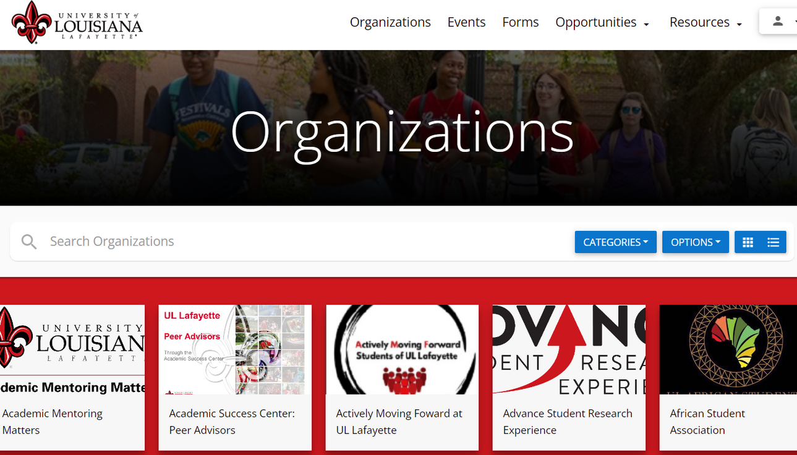

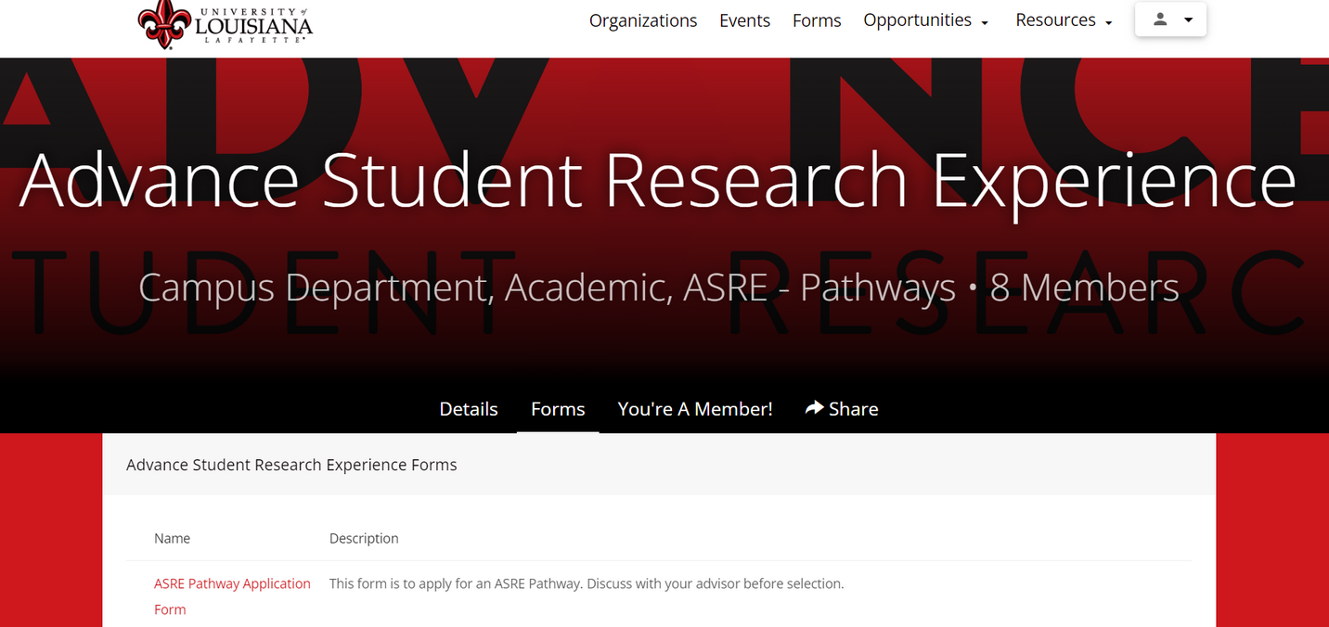

Students will apply through the Advance Student Research Experience organization with the ASRE Pathway Application form.

Slide 7


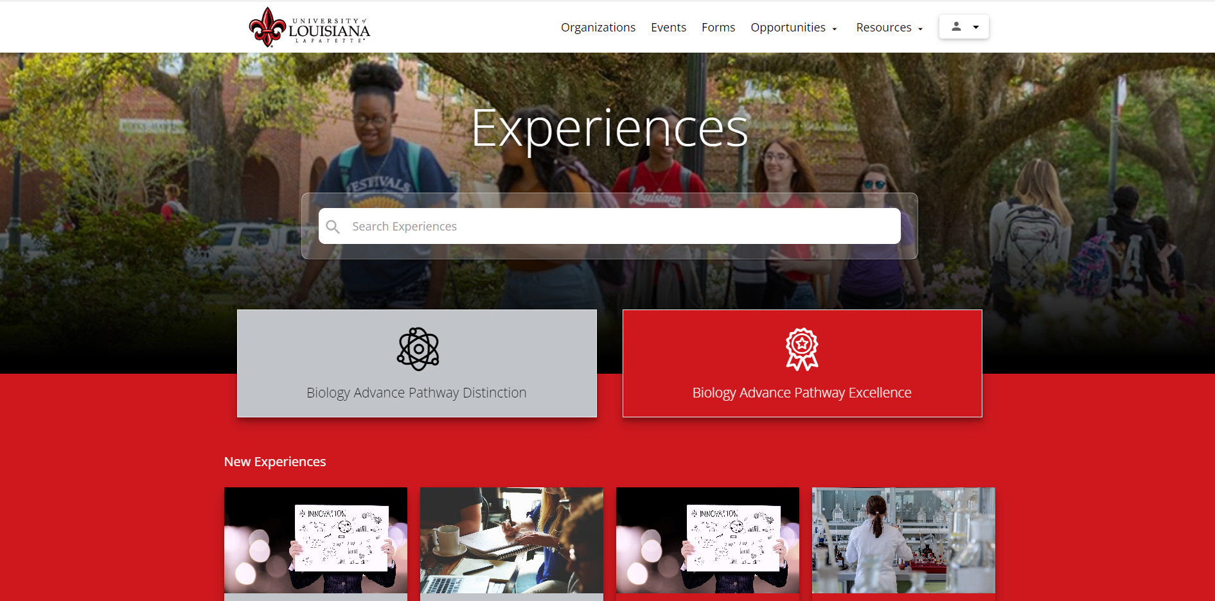
PATHWAYS-STUDENT VIEW

Slide 8
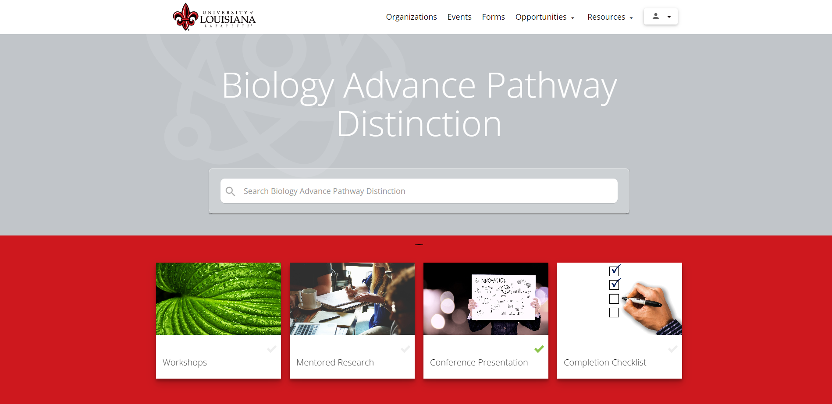
PATHWAYS-STUDENT VIEW
REQUIREMENTS

Slide 9

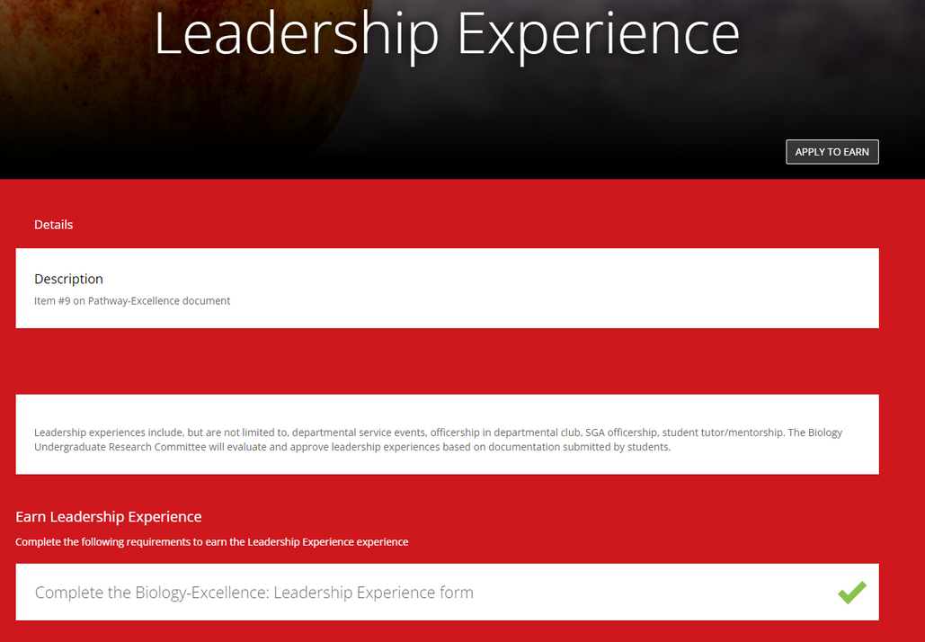
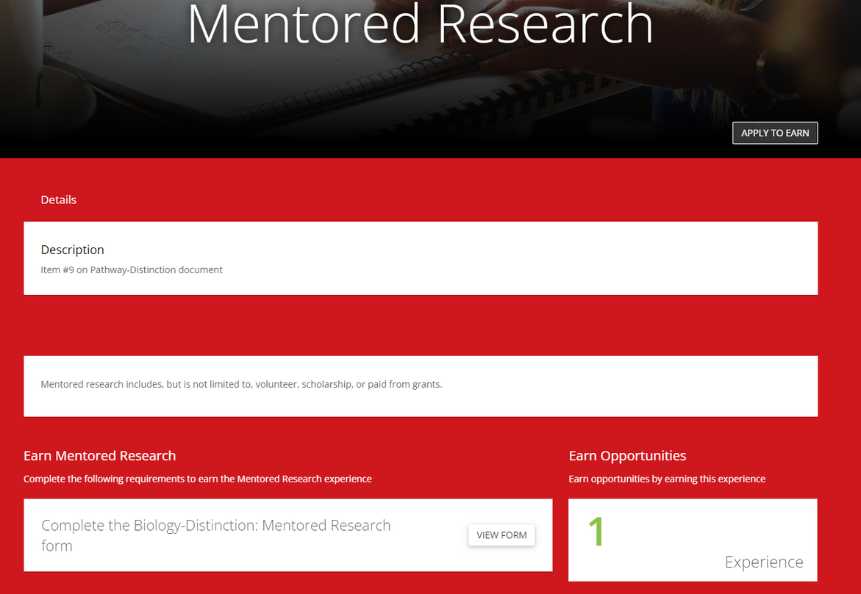

PATHWAYS-STUDENT VIEW
COMPLETED EXPERIENCE
INCOMPLETE EXPERIENCE

Slide 10
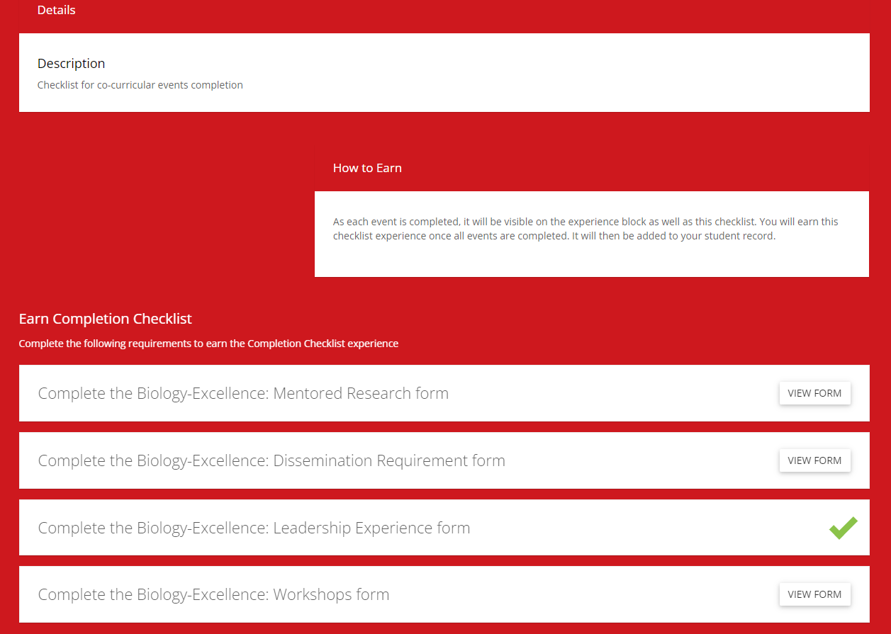

PATHWAYS-STUDENT VIEW: CHECKLIST
Students can view which requirements have been completed and which ones still need completing.

Slide 11

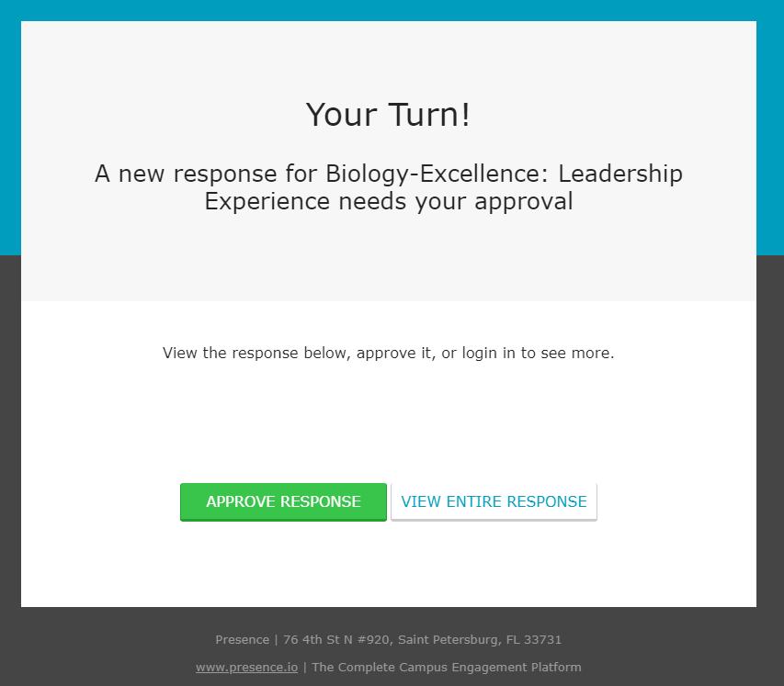
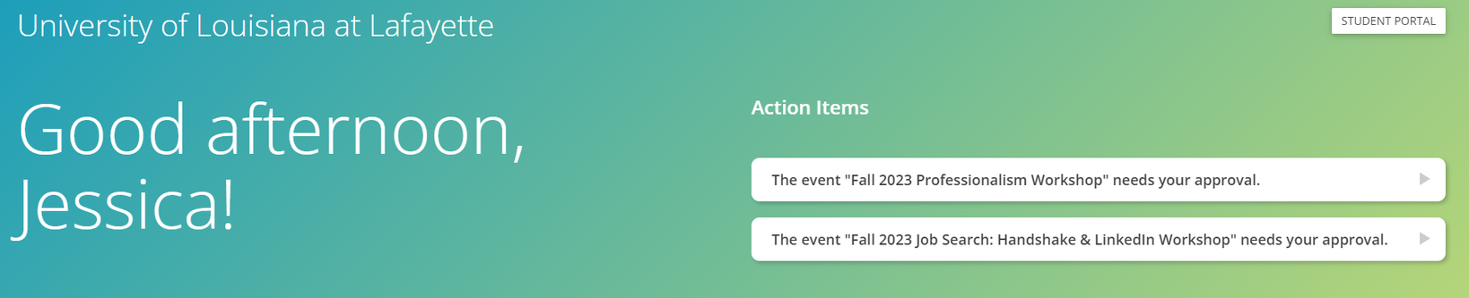

ADMINISTRATOR VIEW
  2-4 departmental organization administrators to approve
  Emails come from Presence/Pathways
  Select "View Entire Response" NOT "Approve Response"
  Admin Dashboard will show forms awaiting approvals

Slide 12


COMPLETION!
Once all events are completed and approved, and courses are passed, the student will receive a designation on their transcript notating the Pathway they achieved.

Slide 13


THANK YOU
Have any questions or want to get started?
jessica.thibodeaux@louisiana.edu
Dupre' Library Room 102

